Slide 1


Where People Live, What Climate Delivers Population-weighted climate exposure assessment
Shivang Pandey
Doktorand
Karolinska Institutet
Population Health Impacts from Climate Extremes and Climatic Factors: 1st October, 11:00 AM

Slide 2
Overview
Climate and Population Health
Climate related Determinants
Working with Climate Data
Linking Climate Data with “People”
Population Weighted Mean

Slide 3





Climate Determinants of Health
Climate and Population Health | Climate related Determinants | Working with Climate Data | Linking Climate Data with “People” | Population Weighted Mean
Climate
Extreme temperatures
Water Quality and Quantity
Air Quality

Slide 4







Climate Determinants of Health
Climate and Population Health | Climate related Determinants | Working with Climate Data | Linking Climate Data with “People” | Population Weighted Mean
Direct Impacts
Cardiovascular
Respiratory
Mortality
Physical Injuries
Indirect Impacts
Infectious Diseases
Food Security
Migration
Mental Health

Slide 5
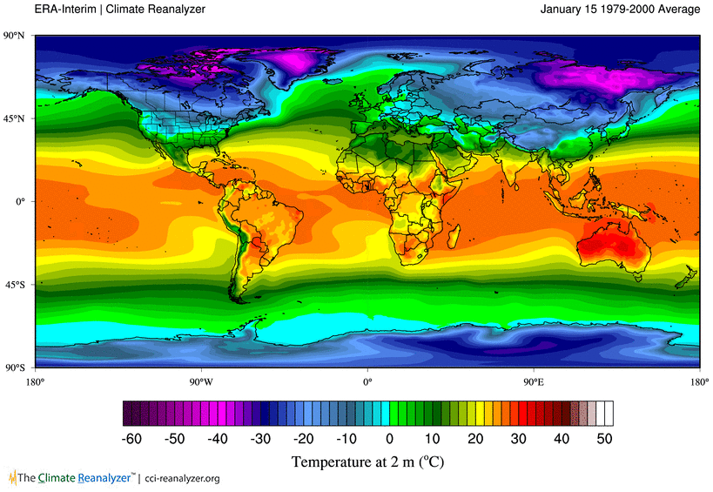
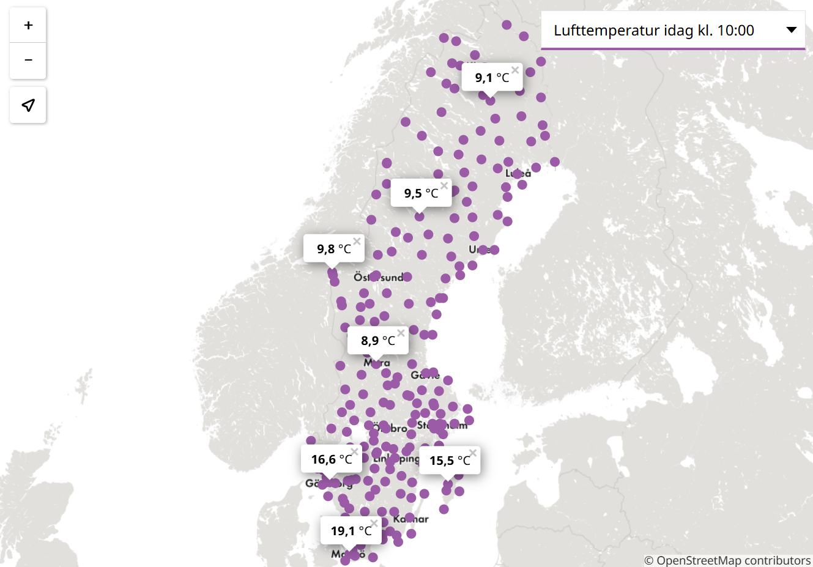
Working with Climate Data
Climate and Population Health | Climate related Determinants | Working with Climate Data | Linking Climate Data with “People” | Population Weighted Mean
Swedish Meteorological and Hydrological Institute: https://www.smhi.se/
Notes:
Information about objects, events, or phenomena that have a location on the Earth's surface, usually identified by coordinates like latitude and longitude

Slide 6


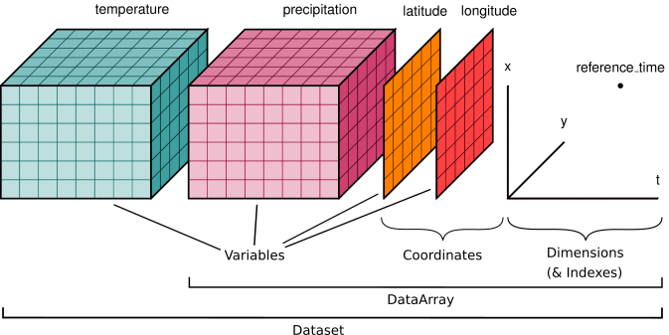


Working with Climate Data – Raster Data
Climate and Population Health | Climate related Determinants | Working with Climate Data | Linking Climate Data with “People” | Population Weighted Mean
How to “see” climate data
Geospatial data
Raster file
Xarray: N-D labeled arrays and datasets in Python
Notes:
Information about objects, events, or phenomena that have a location on the Earth's surface, usually identified by coordinates like latitude and longitude
geographic information that divides an area into a grid of equally sized cells, or pixels, where each pixel contains a specific value representing a feature, attribute, or measurement (like temperature or elevation) at that locatio

Slide 7
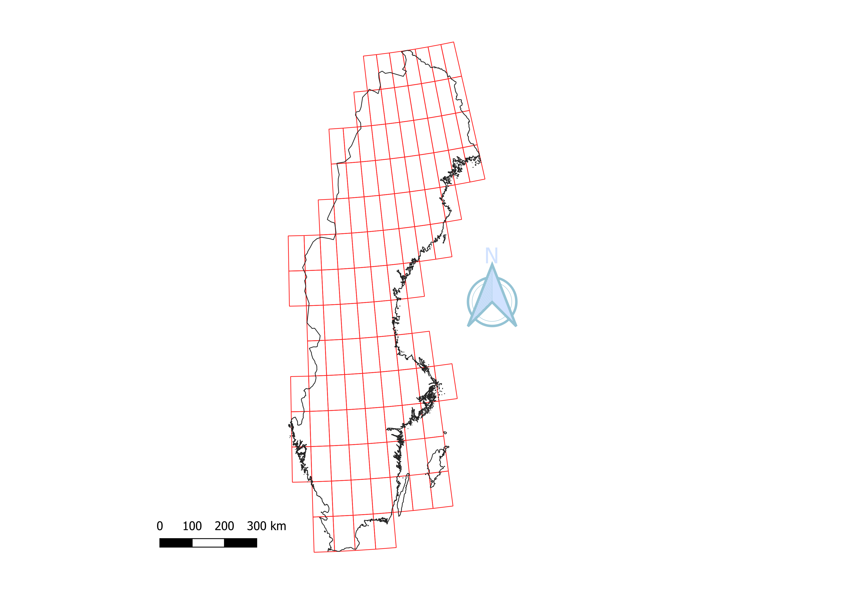
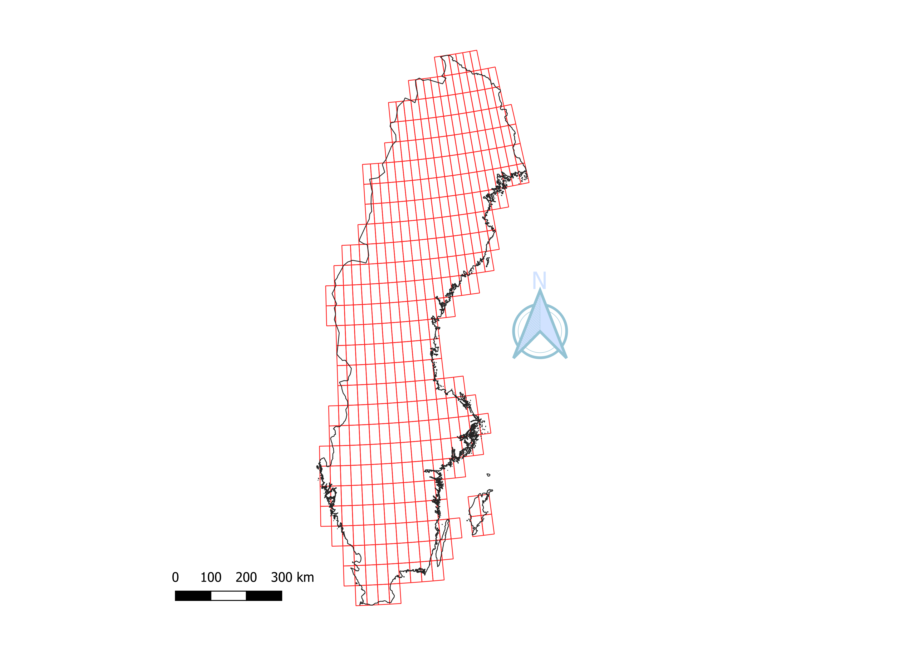
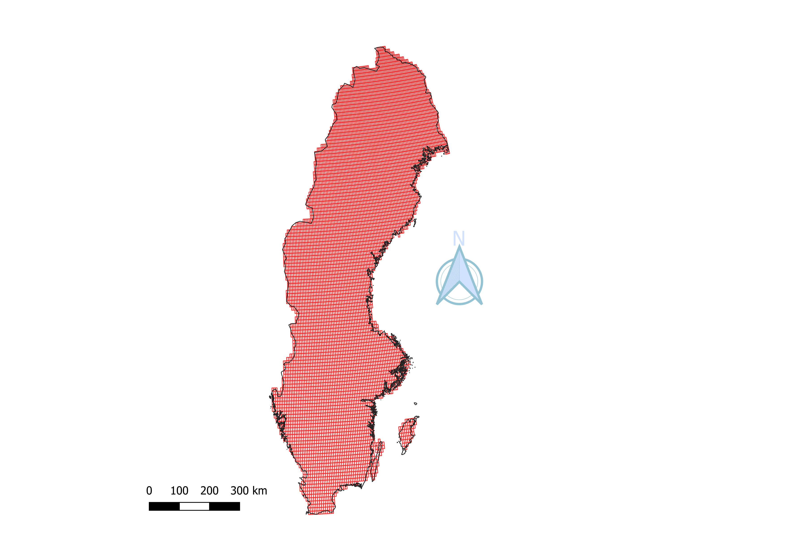

Spatial and Temporal Resolution
Climate and Population Health | Climate related Determinants | Working with Climate Data | Linking Climate Data with “People” | Population Weighted Mean
1º or 112km
(approx.)
0.5º or 55km
(approx.)
0.25º or 27km
(approx.)

Slide 8
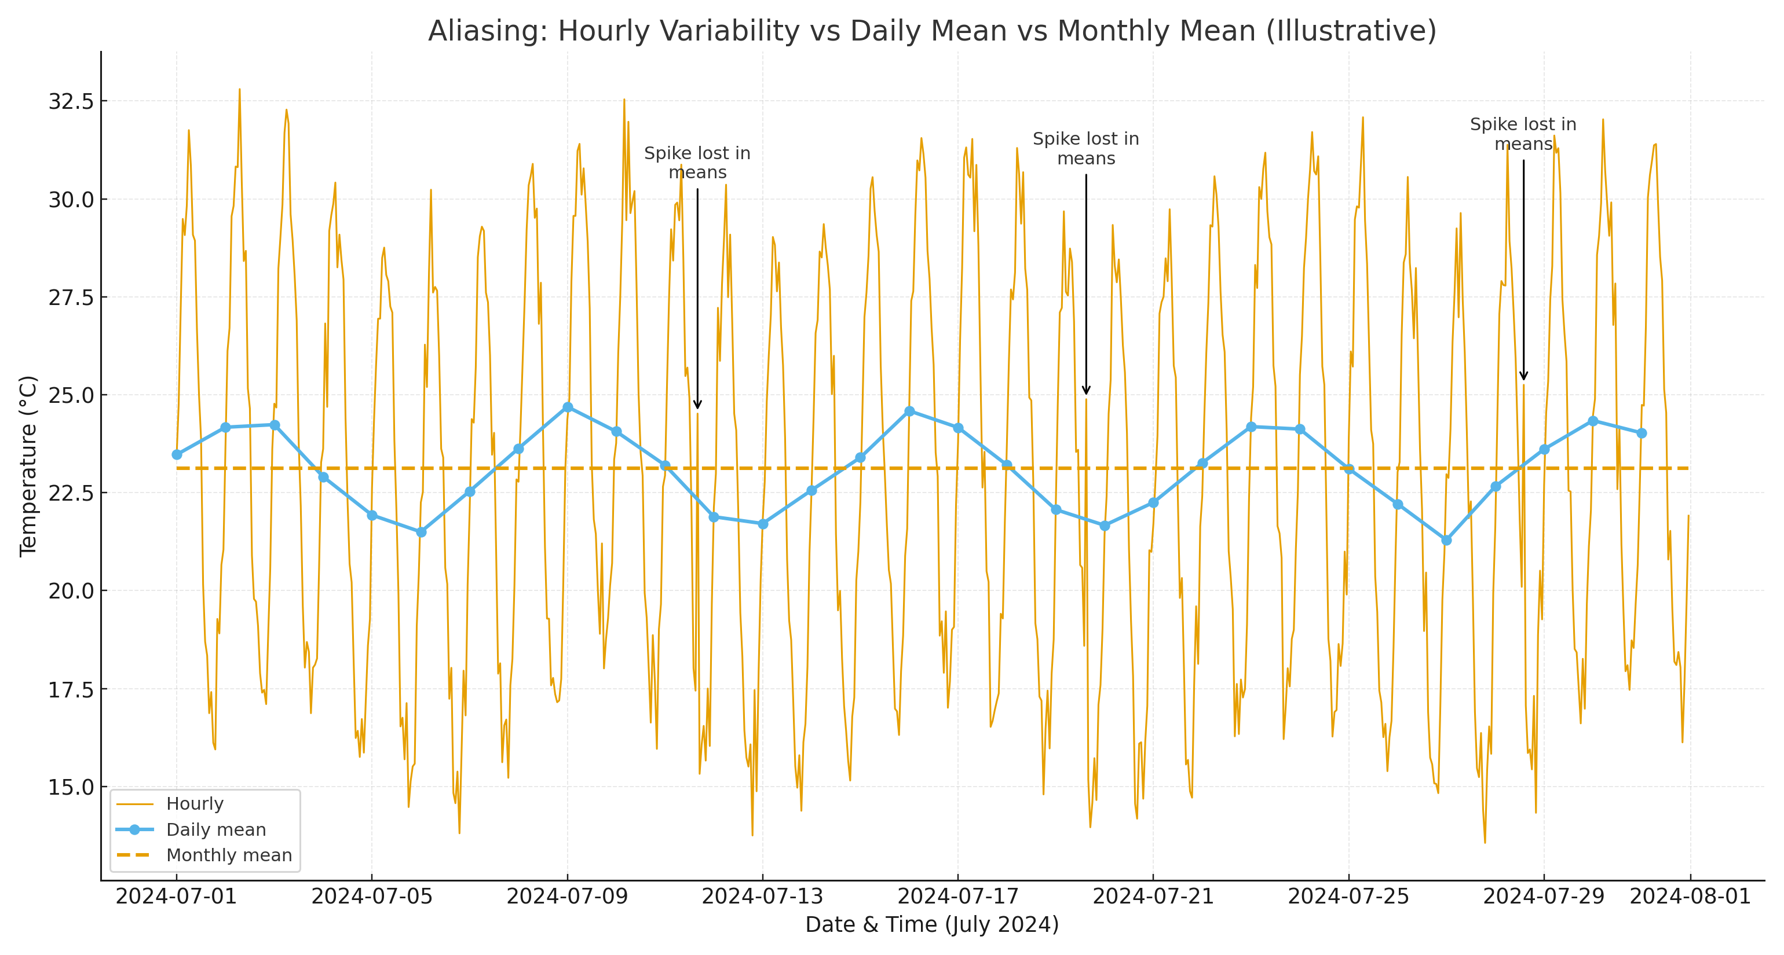
Spatial and Temporal Resolution
Climate and Population Health | Climate related Determinants | Working with Climate Data | Linking Climate Data with “People” | Population Weighted Mean

Slide 9
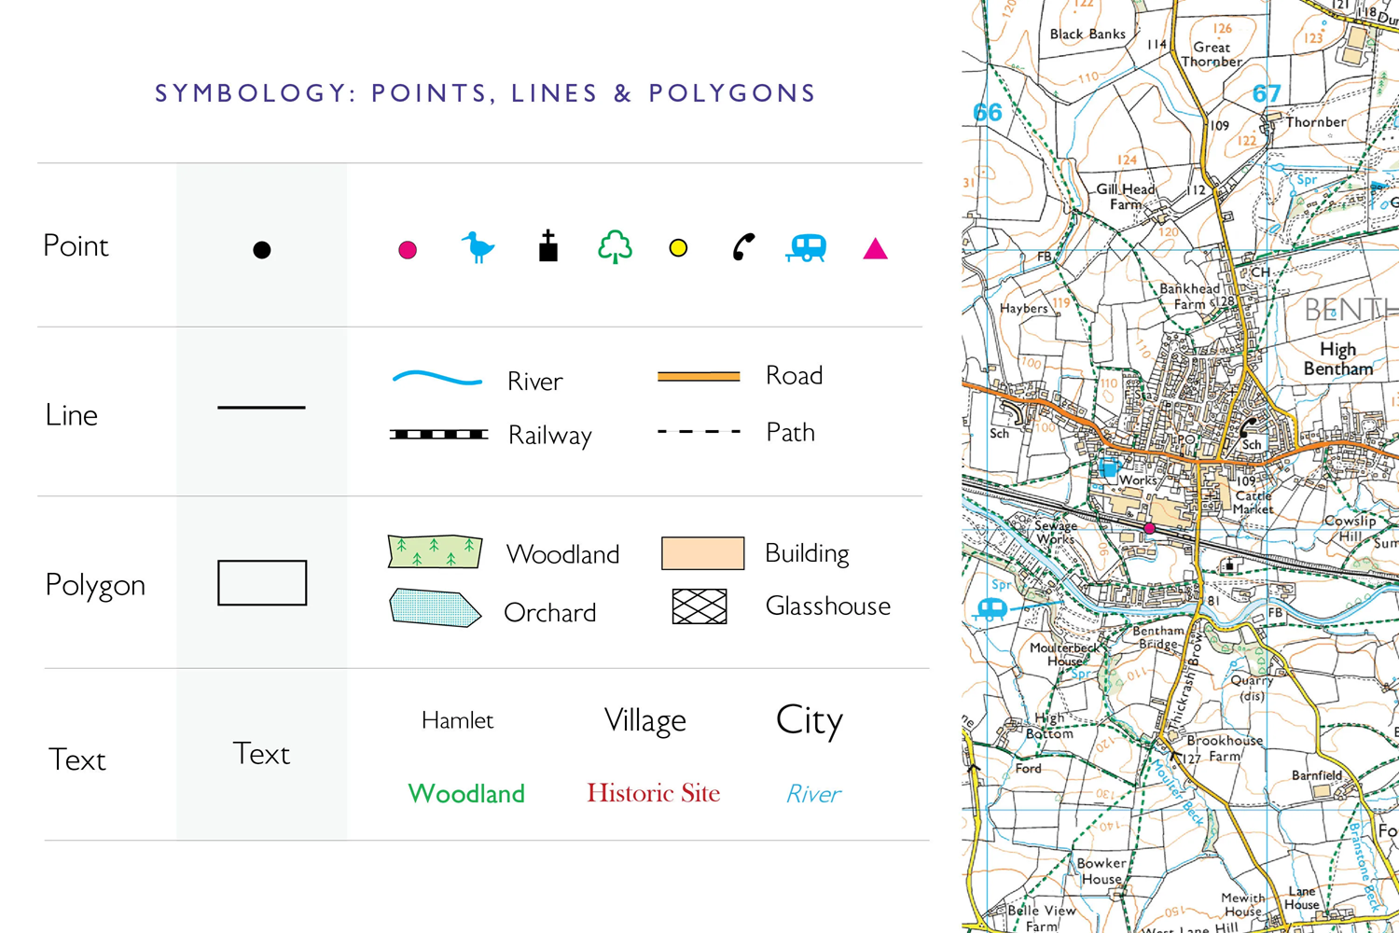
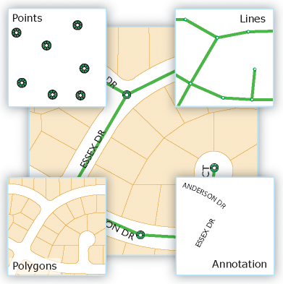
Linking Climate Data with “People” (or their location?) – Vector Data
Climate and Population Health | Climate related Determinants | Working with Climate Data | Linking Climate Data with “People” | Population Weighted Mean
Notes:
that represents real-world features using precise mathematical descriptions of points, lines, and polygons defined by (x, y) coordinates

Slide 10
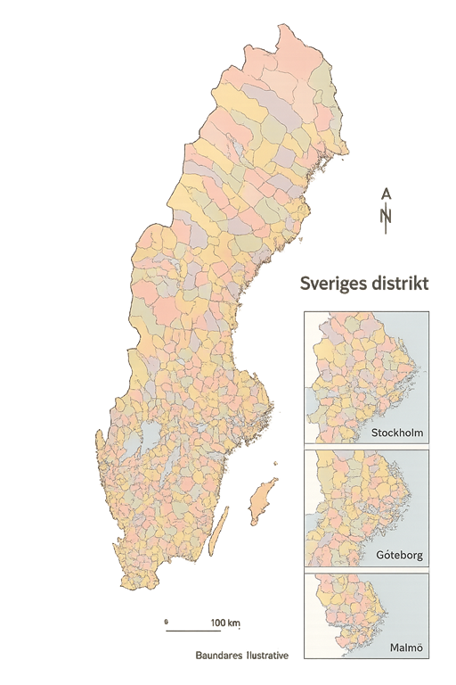
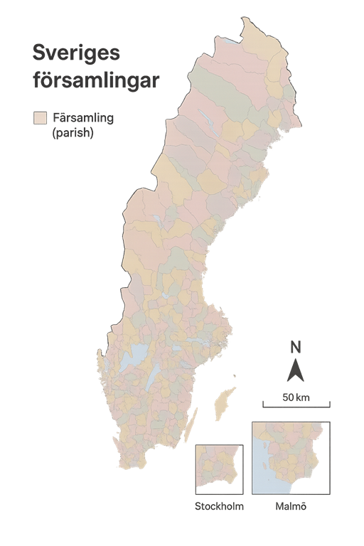
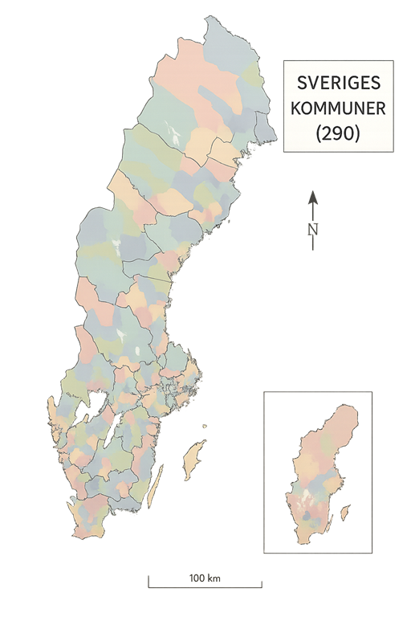
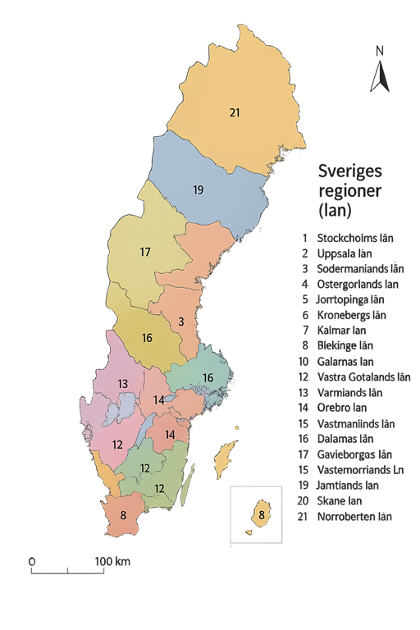
Administrative Layers
Climate and Population Health | Climate related Determinants | Working with Climate Data | Linking Climate Data with “People” | Population Weighted Mean

Slide 11
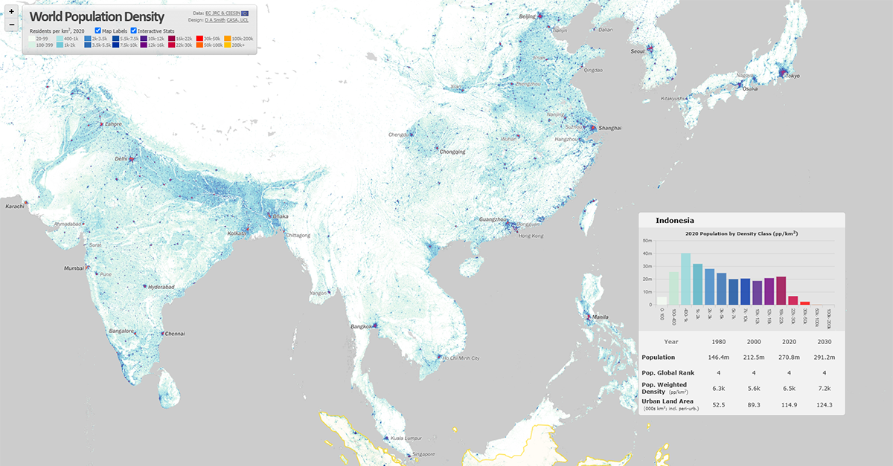
Population Weighted Mean
Climate and Population Health | Climate related Determinants | Working with Climate Data | Linking Climate Data with “People” | Population Weighted Mean

Slide 12
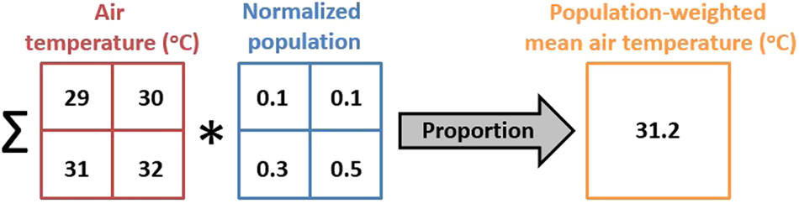
Population Weighted Mean
Climate and Population Health | Climate related Determinants | Working with Climate Data | Linking Climate Data with “People” | Population Weighted Mean
District (polygon) -> Population (grid) -> Temperature (grid)
District wise SINGLE value temperature value
Different for each time stamp

Slide 13
Discuss with your neighbour ~ 1 min
You have:
Annual population data (gridded per district)
Hourly temperature data (gridded)
Daily hospitalization data (per district)
At what resolution and why would you calculate the population-weighted mean temperature for your study?
Final Dataset:
District-level, daily population-weighted mean temperature matched to daily hospitalizations.

